Slide 1

Automation Challenges in Electrical Engineering
This presentation covers automation challenges in electrical engineering. We will focus on a specific problem. Our team members are SARA SAIF, HASEEB UR REHMAN, SHEZA NAVEED & M. TASEER from section 6. Date: . This presentation is for Communication Skill.

Slide 2





Presentation Roadmap
Problem Definition
Introduce the scope and impact.
Technical Analysis
Detail root causes and factors.
Limitations
Inefficiencies of current strategies.
Proposed Automation Solution
Design and implementation of our solution.
Conclusion
Benefits, future implications, and scalability.

Slide 3

Introduction to [Specific Problem]
Definition: [Specific Problem] is a critical challenge. An example is grid instability due to renewable energy integration.
Scope: Renewable energy curtailment costs utilities billions. SCADA system vulnerabilities lead to security breaches.
Impact: It results in economic losses and safety risks. Operational inefficiencies are also a concern.

Slide 4
Root Causes and Contributing Factors
Technical Explanation
Data and Statistics
The intermittency of solar and wind power leads to voltage fluctuations.
Renewable energy penetration vs grid frequency deviations
Outdated SCADA systems lack encryption.
Traditional motors energy vs variable-speed drives

Slide 5
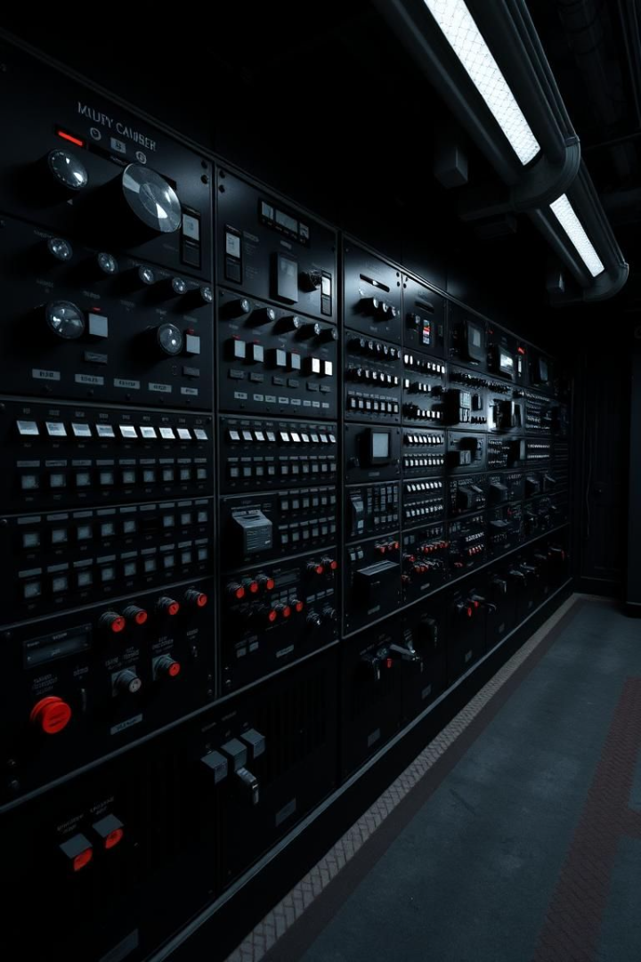
Current Mitigation Strategies
Overview of Existing Solutions
Limitations
Manual load shedding is slow and costly. Energy audits are expensive and time-consuming.
Grid operators use manual load shedding.
Energy audits are used to improve motor efficiency.
Cost Analysis
Manual load shedding has an annual cost. Retrofits have a payback period. Breaches are costly.

Slide 6
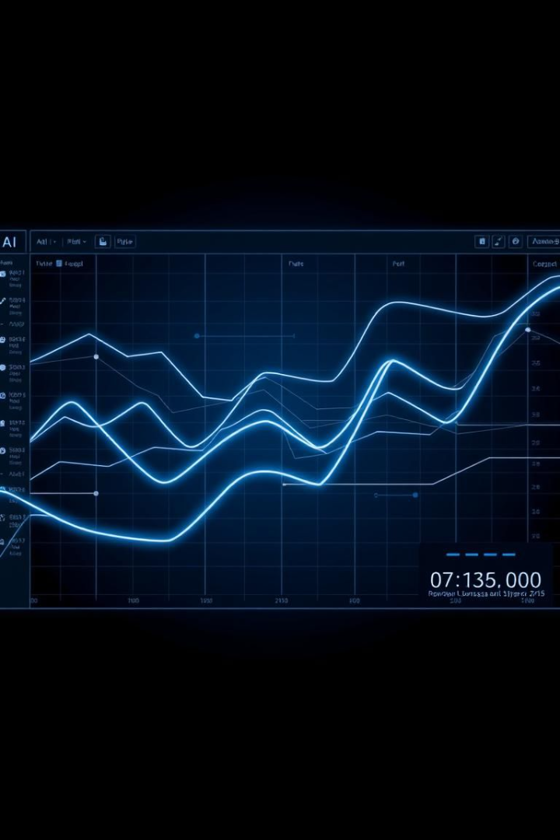



Proposed Automation Solution
AI-powered Grid Management
Predictive Maintenance System
Blockchain Cybersecurity
Develop an AI-powered grid system. Implement a predictive system. Develop a blockchain platform.

Slide 7



Conclusion: Benefits and Implications
1
Improved Efficiency
2
Enhanced Security
3
Sustainable Energy
Our solution offers quantifiable benefits. It has long-term impacts on industry. The solutions is readily deployed.

Slide 8

Questions & Discussion
Thank you for your attention. I am open for questions and further discussion.

